Slide 1
Poverty
Human Development Psychology 1 – Patrice Salomon
Samantha De Rosa (1431549)
Ruby Alice Nomie Alphonse (1711397)
Sayraya Jean-Joseph

Slide 2
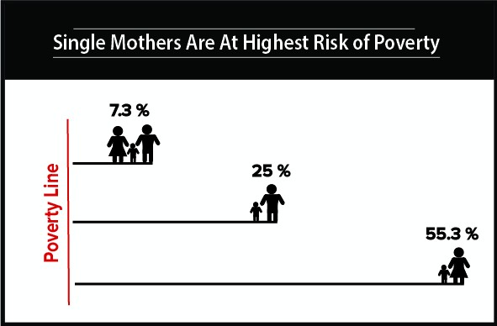
Single mothers and poverty…

Slide 3
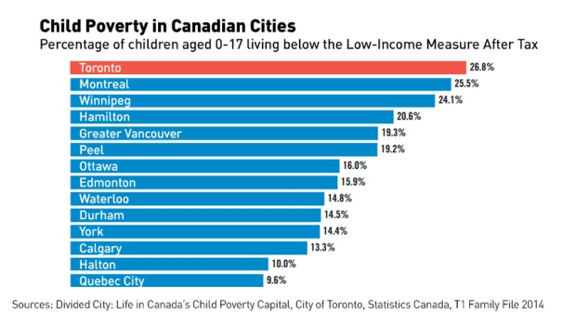
Statistics
Canada’s child poverty remains 133,000 children living in poverty.
In Toronto, Child poverty affects the ability of children to access important programs. EX: childcare, early learning, and extracurricular activities,
“Families with income below 30,000$, 48% of children don’t regularly attend sports or activities outside of school.”

Slide 4
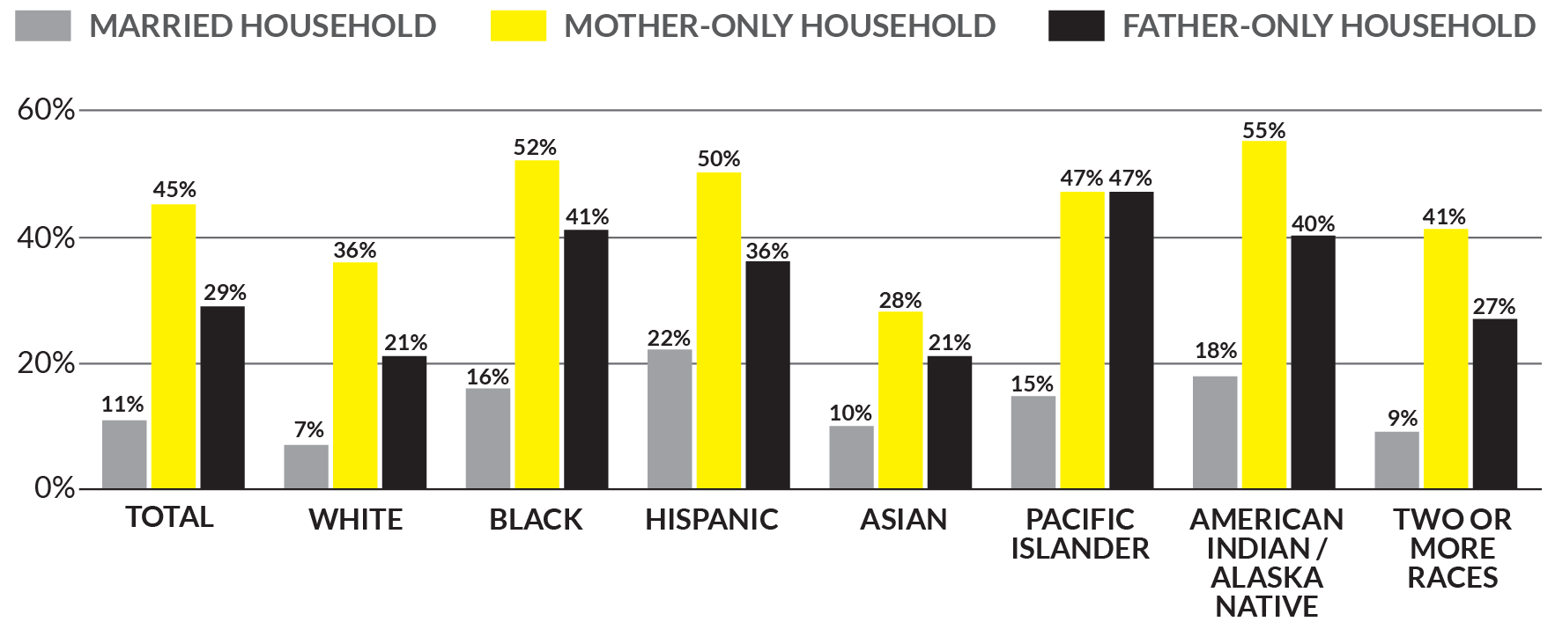
Statistics continued..

Slide 5
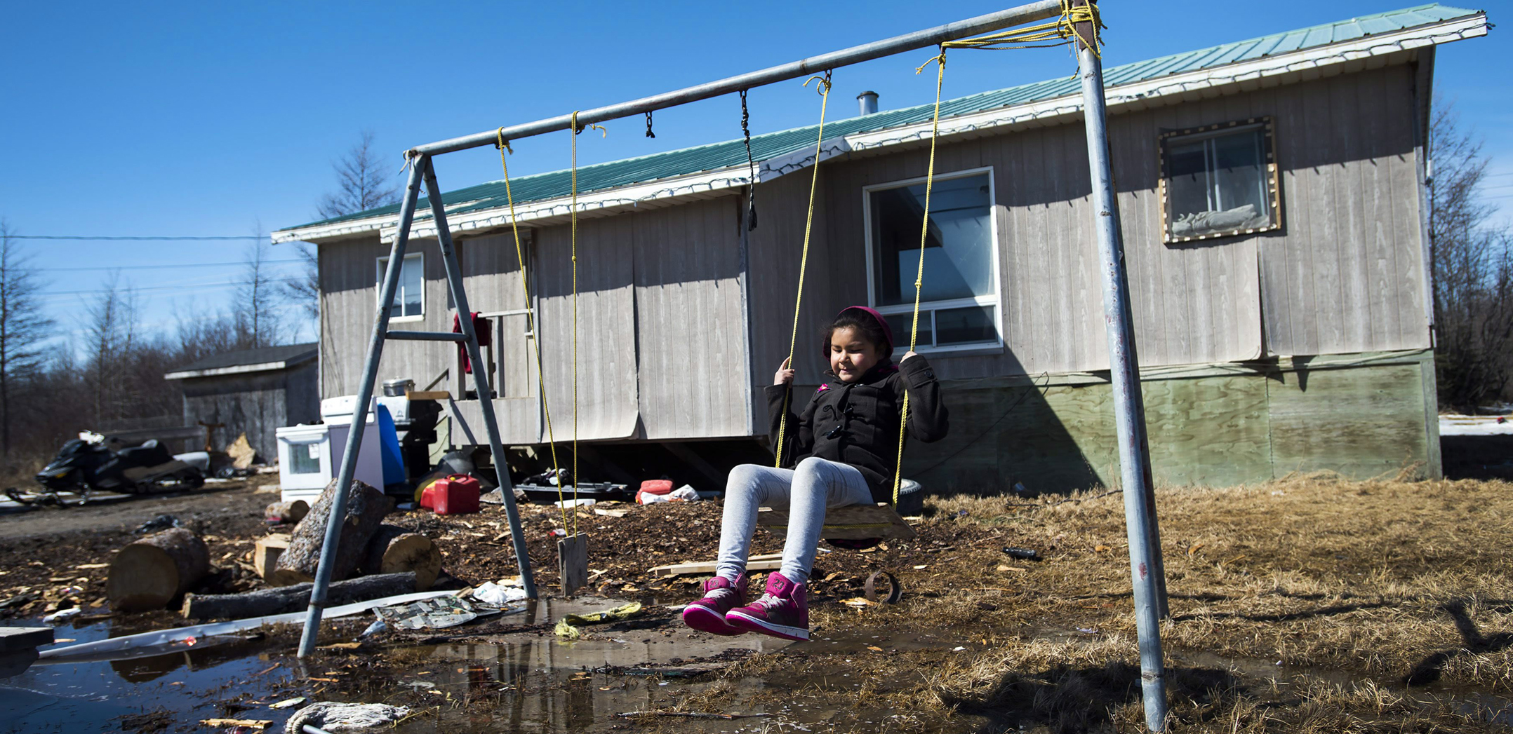
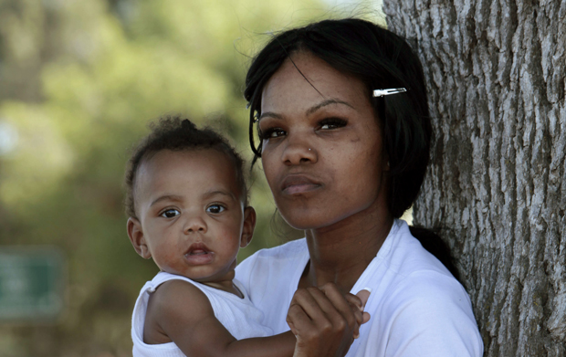
Poverty…

