Slide 1
Portfolio
Intro to Pastry with Chef Mandy
Jorge Villacarlos

Slide 2
Table of Contents
Week 1
Week 2
Week 3
Week 4
Week 5
Week 6
Week 7
Week 8
Week 9
Week 10
Week 11

Slide 3
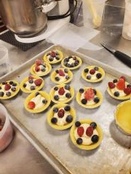
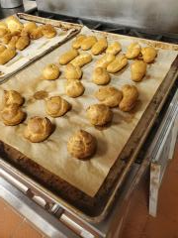
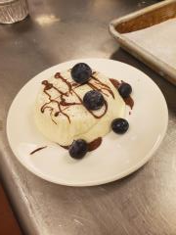
Week 1 Panna cotta Frangipan Choux
The Panna cotta was good however I think it was too jiggly. Takes the most time but I am comfortable making it
Choux was well baked with the pastry tasted good
For the frangipan very simple and presentable to the eye.
Overall, I think piping is an important technique I learned in week 1

Slide 4
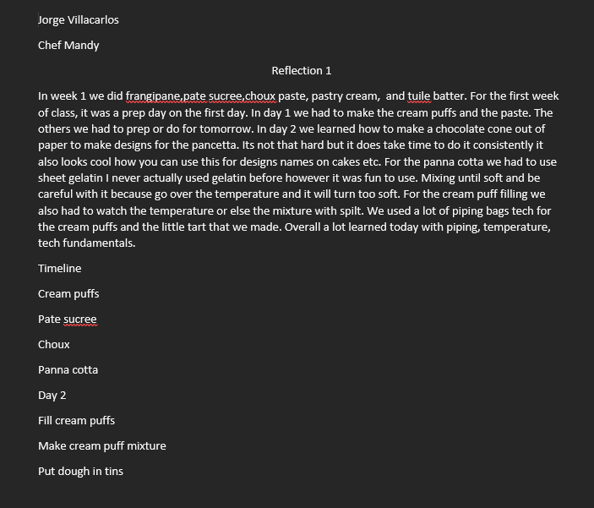
Journal Week 1

Slide 5
Personal Thoughts
In week 1 like baking I thought it was hectic. Making a lot of desserts with good timing and multi- tasking is important. But I can safely say that I learned a lot from piping and using chocolate to write.

Slide 6
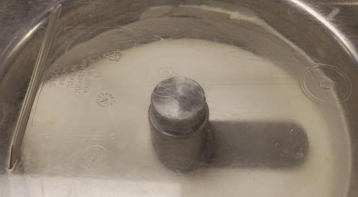
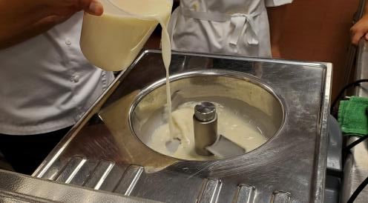
Week 2 Sabayon Crème brulee’ Mango sorbet
Week 2 we did sorbet, crème brulee, and Lemon Sabayon.
The reason why there is barely any photos is because this is the day, I got the vaccine (2nd dose)
Missed out on the crème brulee and Sabayon

Slide 7
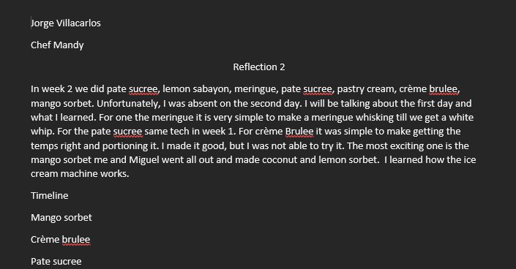
Journal Week 2

Slide 8
Personal Thoughts
Not much I can say however seeing the ice cream machine do its work is quite interesting and I put a twist I made lemon sorbet which tasted great. For what I learned well I learned how to make ice cream and seeing it come together is a great experience

Slide 9
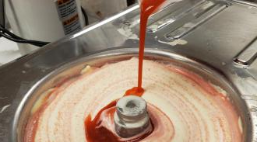
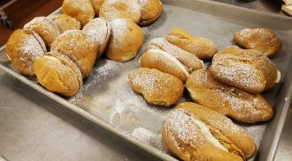
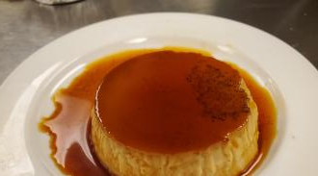
Week 3 Ice cream Choux paste Peanut butter pie Caramel Flan
The Ice cream like week 2 I used strawberries to flavour my Ice cream.
For the choux paste It was overworked too much eggs and it doesn’t look too good compared to the last one that I made
For the flan my caramel became bitter. Everything was perfect except my caramel.

Slide 10
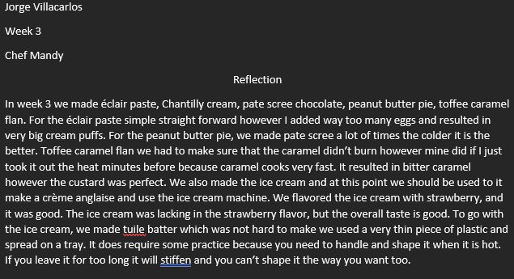
Journal Week 3

Slide 11
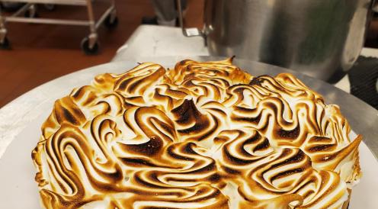
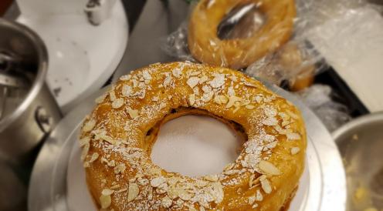
Week 4 Lemon Sabayon (No photo ☹) Swiss Meringue Choux Paris-Brest
Lemon sabayon the one that I couldn’t make there is no photo, but I was well made, and It set nicely.
For the choux I would say more effort on piping the sides it was fun to make
Swiss meringue is also fun I enjoyed using the blowtorch to make a nice colour on the meringue.

Slide 12
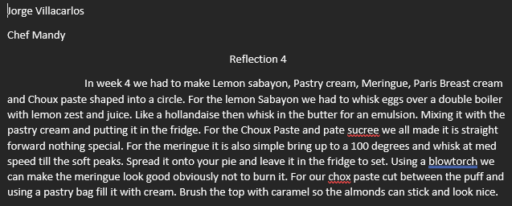
Journal week 4

Slide 13
Personal Thoughts
This week I learned about using the blowtorch and using the piping bag more effectively. Cutting skills from the cake to make the perfect edges. Overall I had a good day.

Slide 14
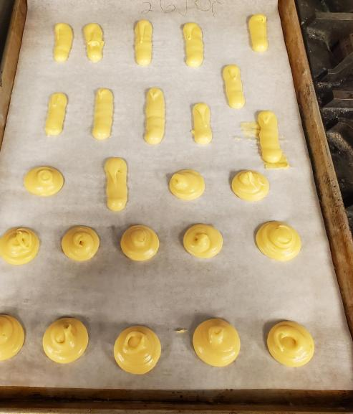
Week 5 Midterm (missing photos) Choux paste Panna Cotta Tuile Cookie Lemon Sabayon
For starters my choux is shaped quite well since the last one.
My panna cotta was better because I was more efficient with my work and set it in the fridge.
Tuile cookie is simple to make nothing special except working at it when its hot
Lemon sabayon for this week turned runny I didn’t set it in the oven that why it turned that way.

Slide 15
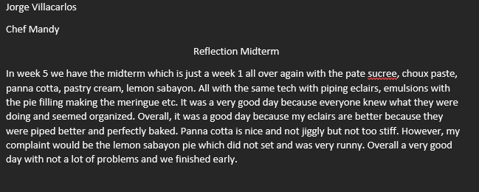
Journal Week 5

Slide 16
Personal Thoughts
For me, the midterm went well because I got comfortable with my piping skills. Furthermore, my panna cotta set the way I wanted too not to runny and jiggly. For the lemon sabayon it is a shame that it turned out runny however knowing mistakes can help. My choux turned out well I used less eggs and it turned great. Good midterm and a lot of experience gained throughout this week.

Slide 17
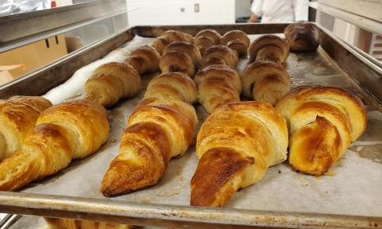
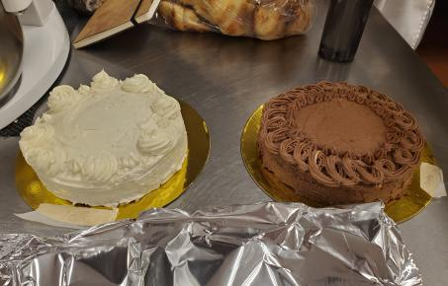
Week 6 White Genoise Chocolate Genoise Italian Buttercream Simple Buttercream Croissants Cocoa Fudge Icing

Slide 18
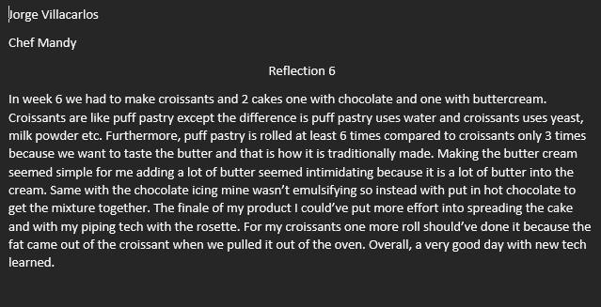
Journal Week 6

Slide 19
Personal Thoughts
For week 6 making the butter cream at first it seems intimidating because you must add a lot of butter to make an emulsion to have a creamy consistency. For the croissants need to fold 3 times so it becomes laminated. The experience for me is great working with croissants for the first time and making a cake with the icing on it. The croissants smelled incredible as they came out of the oven.

Slide 20
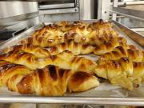
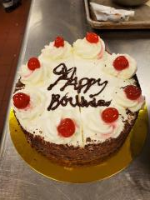
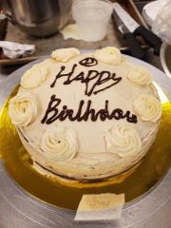
Week 7 Chocolate Genoise Italian Buttercream(coffee flavor) Simple Buttercream Orange Glazed Croissants Tuxedo Cake

Slide 21
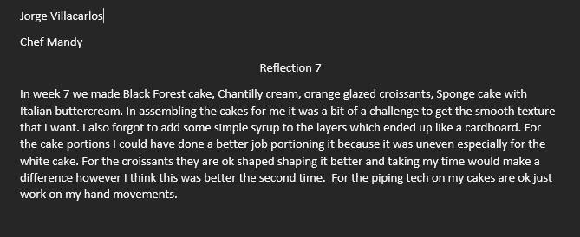
Journal Week 7

Slide 22
Personal Thoughts
Week 7 we made black forest cake and for me making these cakes were a challenge because spreading the cake icing seemed hard for me. Making sure the edges were nicely coated and because my sponge barely made 3 separate slices. But most of all there were croissants which were once again great especially with the orange glaze fresh citrus flavor.

Slide 23
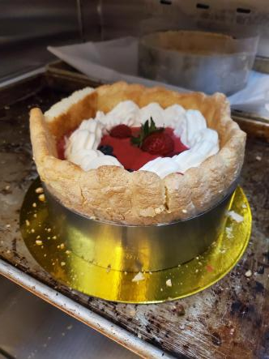
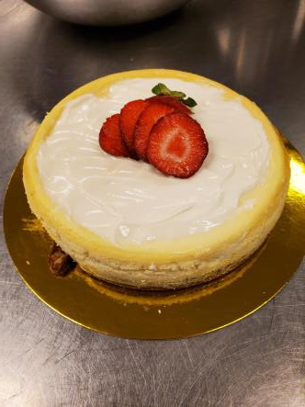
Week 8 Cheesecake Lady Fingers Raspberry mousse Danish(No photo)

Slide 24
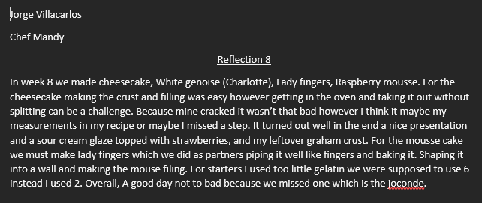
Journal Week 8

Slide 25
Personal Thoughts
The raspberry mousse cake was runny because I put little sheet gelatin, but the look of the cake is very nice. Making the lady fingers was a nice experience because piping needs more tech than usual not to make it too runny. For the cheesecake, my first time ever making one except when it cracked but I enjoyed the experience taste nice in the end.

Slide 26
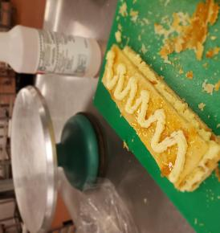
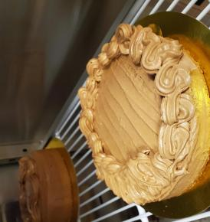
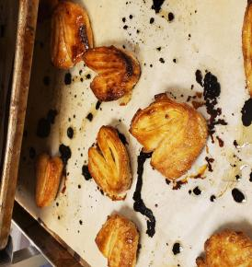
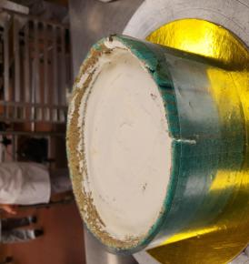
Week 9 Puff Pastry Joconde Cake Almond genoise

Slide 27
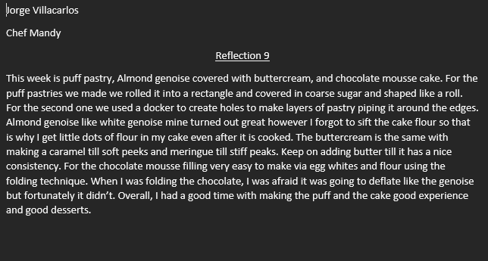
Journal Week 9

Slide 28
Personal Thoughts
I think the puff pastry was the highlight it was my first time making one and similarly to a croissant with turning and folding the butter in using the machine. The difference that I learned when comparing puff and croissants is that croissants use milk powder, yeast etc. While puff uses water so there is no need to proof the dough roll it out and bake. For the cake it is very simple, and I am used to it however I did need to work on my piping tech,

Slide 29
Final Thoughts
My experience with the class has been amazing. The workload is a lot but sure is it worth it. The amount of work was overwhelming with a lot of recipes however chef was helpful, and I can say that Chef is great at giving feedback and helping us understand how to make recipes. For example, buttercream, Italian meringue etc. Helpful in teaching us in demos very clear. Overall, I have gained so much in piping, layering cakes, making different pastries etc. This class will help me in the future and further beyond.

