Slide 1
Portfolio
Baking with Chef Mandy

Slide 2
Table of Contents
Week 1 Slides 3-5
Week 2 Slides 6-8
Week 3 Slides 9-11
Week 4 Slides 12-14
Week 5 Slides 15-17
Week 6 Slides 18-20
Week 7 Slides 21-23
Week 8 Slides 24-26
Week 9 Slides 27-29
Summary

Slide 3
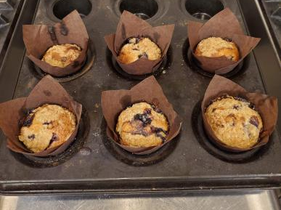
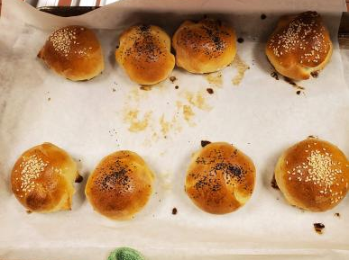
Week 1 Blue Berry Muffins Soft Yeast Dinner rolls Peanut butter sandies(No picture) ☹
For the Muffins we made a batter that must be lumpy
Berries must be floured
Streusel is sprinkled on top of the Muffin
Soft yeast dinner rolls, Chef Mandy taught us lay the flour on your station and make a well in the center
My first time seeing a proofer
Peanut butter sandies were a bit burnt
Cooking method Was baking in the oven

Slide 4
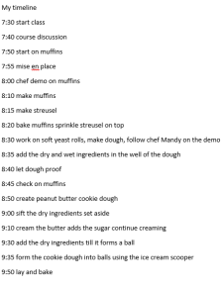
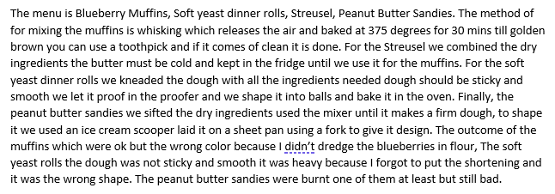
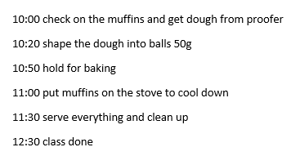
Journal Week 1

Slide 5
Personal Thoughts
My thoughts on week 1 for me it was hectic. I was all over the place in terms of how baking works. Accurate measurements and good techniques

Slide 6
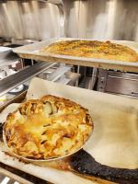
Week 2 Chocolate Chunk Cookies ☹ Roman Flatbread Apple pie
The first time I made pie dough
It became like a dough not with the chunks of fat
The bread is nice and golden brown I had a lot of fun making it. But I put too much rosemary.
Cookies were nicely baked (nice color)
Cooking method is baking in the oven

Slide 7
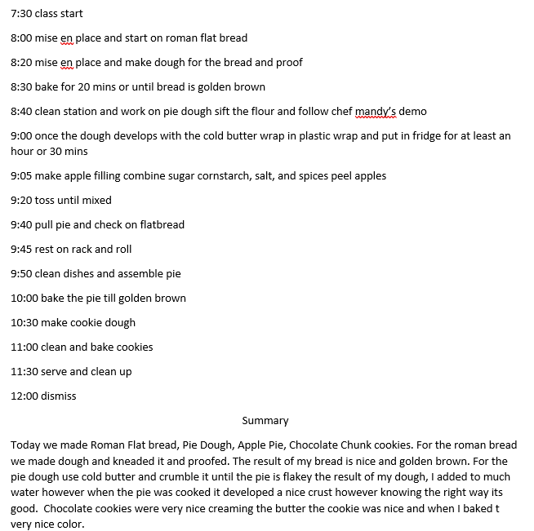
Journal Week 2

Slide 8
Personal Thoughts
The first time I learned about creaming sugar and butter. My first-time making pie dough was nice. Making the bread was quite the process it turned out well in the end. Cookies also turned out well in the end.

Slide 9
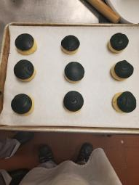
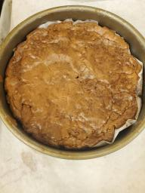
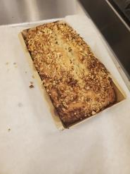
Week 3 Fudge Brownies Banana Bread Italian bread Rosemary topped with conchas
The Italian Bread Rosemary was a good bake never had and they were ok. What was not ok were the concha's they got ripped. Brownies good bake my structure got ruined. Banana Bread looks amazing.
Baking is done in the oven

Slide 10
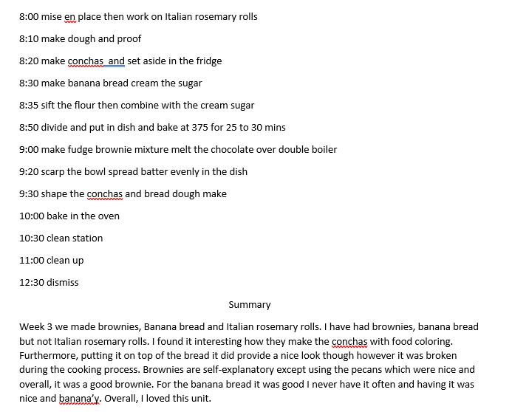
Week 3 Journal

Slide 11
Personal Thoughts
The bread was interesting topping it with the conchas. The brownies although looks bad they taste amazing. Banana bread looks good. I like this menu.

Slide 12
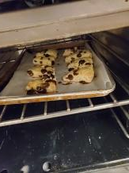
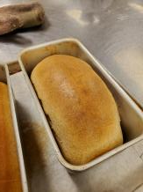
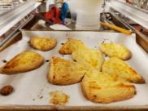
Week 4 White Bread Shortbread Scones
The white bread was fun to make at this point we should have a grasp on how to make bread. Shortbread looks good usually the shape I see is the round shortbreads. Scones looks ok.
Baking was done in the oven

Slide 13
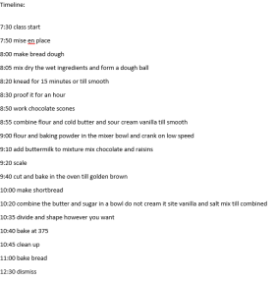
Week 4 Journal

Slide 14
Personal Thoughts
Making the bread was no surprise since we made it so many times. Making the scones was a ride because I kept adding the flour when you are not supposed to do that. Shortbread was simple using the mixer and seeing the dough come together was satisfying.

Slide 15
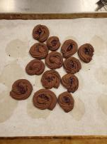
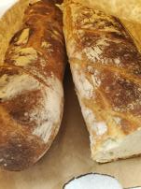
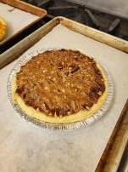
Week 5 Baguette Chocolate Cookies Pecan Pie
Baguette a French bread that is long and mixed with another dough. Chocolate spritz cookies. Pecan pie with pecans a lot of sugars.
Baking was done in oven

Slide 16
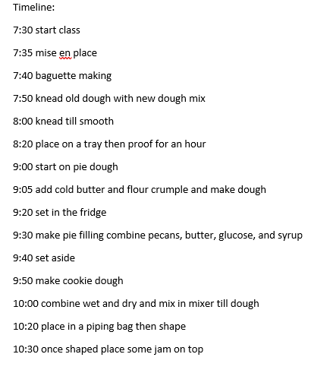
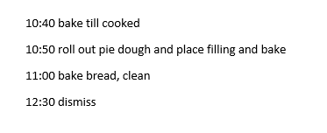
Week 5 Journal

Slide 17
Personal Thoughts
Making the baguette same thing but adding the old dough. Chef Mandy showed us how roll the baguette. We were introduced to glucose syrup which we needed for the pecan pie. We must have wet hands though to grab the glucose. The Chocolate cookies took the most out of me because the mixture was so thick in the pastry bag.

Slide 18
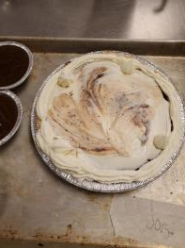
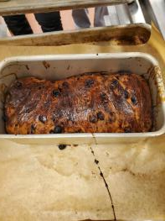
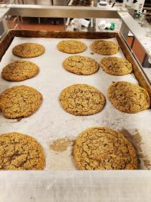
Week 6 Oatmeal cookies, raisin bread, chocolate pie

Slide 19
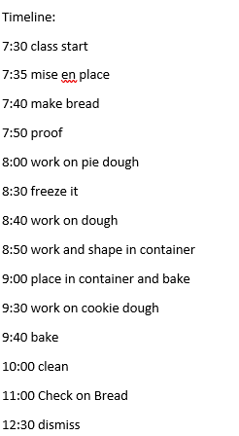
Week 6 Journal

Slide 20
Personal Thoughts
Oatmeal cookies were nicely sized and baked well.
Chocolate pie is nice the whip cream is messed up the photo.
Raisin bread a little tear in the structure. Overall good
Week 6 is nice and fun

Slide 21
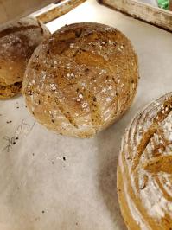
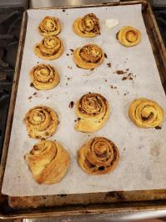
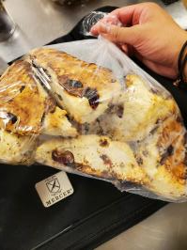
Week 7 Sourdough bread, Pecan rolls, scones with raisins

Slide 22
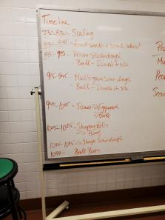
Week 7 journal

Slide 23
Personal Thoughts
The sourdough bread needs an old dough. Which I found interesting. Pecan rolls needed more care they were varied in terms of shape however they were good. The scones once again I added more flour which im not supposed to do.

Slide 24
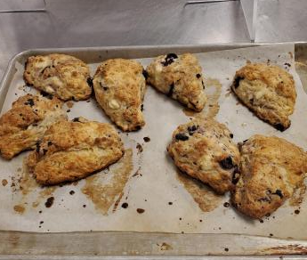
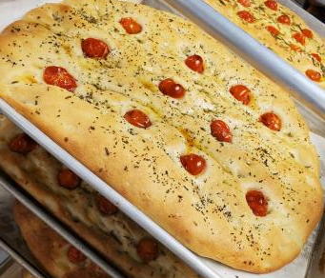
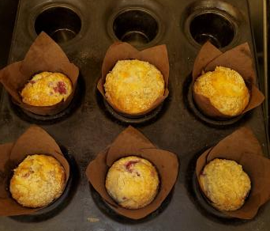
Week 8 Raisin Muffins, Flatbread, Greek scones

Slide 25
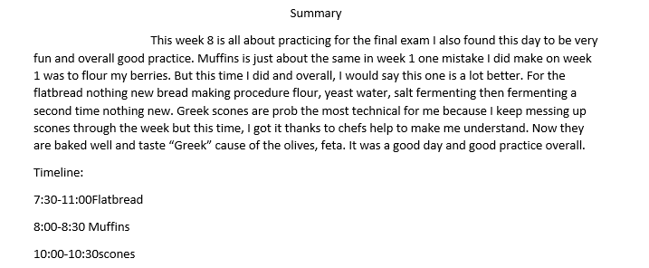
Week 8 Journal

Slide 26
Personal Thoughts
I think this week was a very fun week. It is basically week one and a practice for the exam and this time. My scones were baked and made correctly. Flatbread is better in terms of baking and taste and the muffins bit small but better than my blueberry muffins.

Slide 27
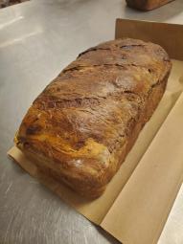
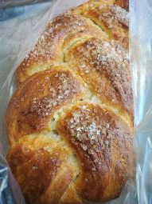
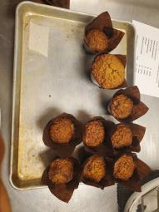
Week 9 Morning Glory Muffins, Brioche Bread, Chocolate bread

Slide 28
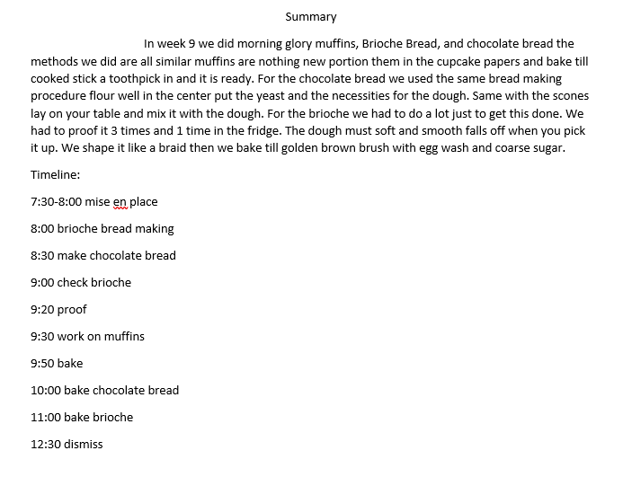
Week 9 Journal

Slide 29
Personal Thoughts
I think that the brioche takes the most effort but was worth it in the end. The muffins were nothing simple. The chocolate was also simple same breadmaking procedure.

Slide 30
Summary
To summarize my week in baking. I learned about making a well in the center of the flour to keep the liquid from falling out. I also learned about the proofer which speeds up the rise of the dough. Usually when I make a dough, I put in the oven just to rise the oven is not on obviously. I learned how to make scones and speaking of scones they were my struggle throughout the class because I always thought that the dough was so wet. So, I added more flour which I’m not supposed to do thanks to chef and being patient, I made a good one in the final exam. The highlight must be the practical exam everyone just seemed so good in scaling and making everything. All the muffins. scones and bread all looked good and most of all tasted good. From what I took away from Baking is that trust your recipes, make sure that scaling is precise I think this is the most important one clean as you go. It becomes a pain when some flour is still on your station and when you make another dough it becomes a pain.

