Slide 1
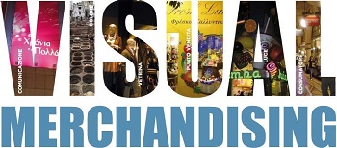
Visual Merchandising,Retail Design, and Interior Design.
Present by Wendy & Ruijie

Slide 2
Architect
Building designer who may work with a wide variety of structures.
Locations are referred to as commercial real estate.
Creative blend of art &science.
Aesthetics, safety, environmental factors.

Slide 3
Architect
Discuss options, costs, materials with clients.
Creates concept drawings on computer.
Communicate the design.
Oversee the work of builders, contractors, plumbers, painters, carpenters, air-conditioning,heating specialists.

Slide 4
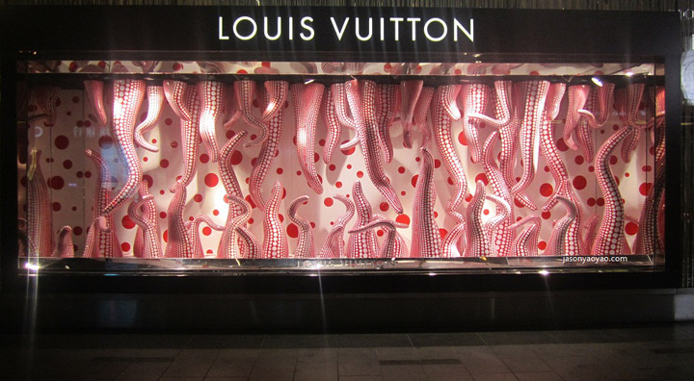

Slide 5
Visual Merchandising
Silent salesperson.
Refers to the design, development,procurement, installation of merchandise displays.
Sells the company’s product lines.

Slide 6
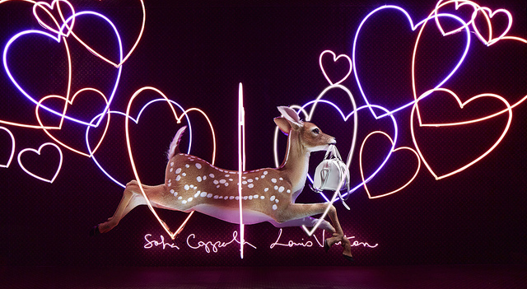

Slide 7
Visual Merchandising
Responsible for window installations, in-store displays, signage, fixtures, mannequins ,decorations.
Stylist of sorts.
Have the ability to create an image of the store, entices customers to enter the store to purchase merchandise.

Slide 8
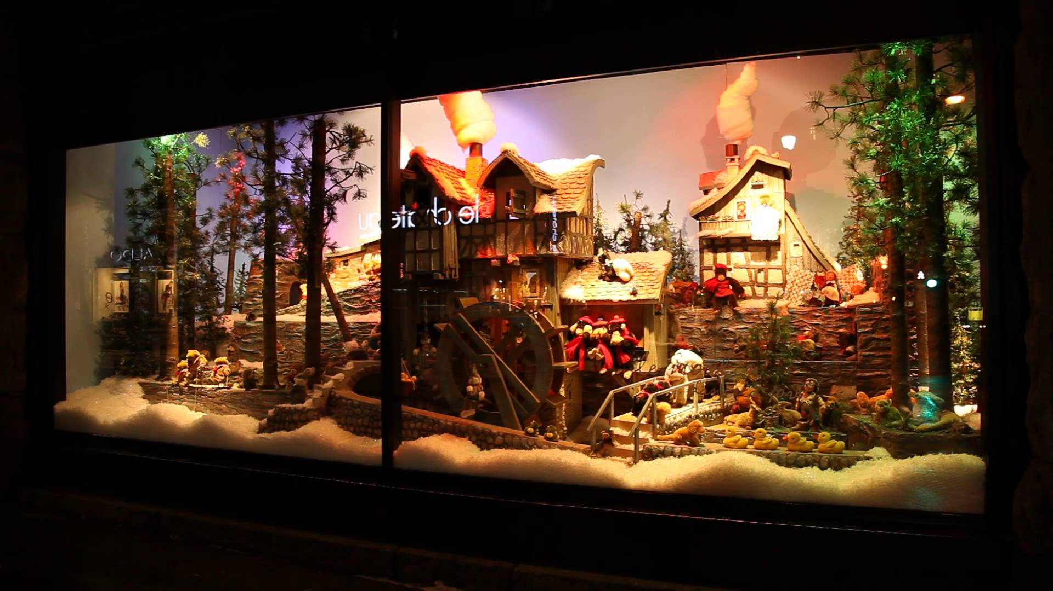

Slide 9
Responsible for several key tasks
Designing an aesthetically appealing environment that reflects the company’s image
Creating exciting visual displays to educate customers and to sell merchandise.
Presenting the merchandise in ways that will maximize sales, such as displaying the full range of colors of a new handbag and matching footwear.

Slide 10
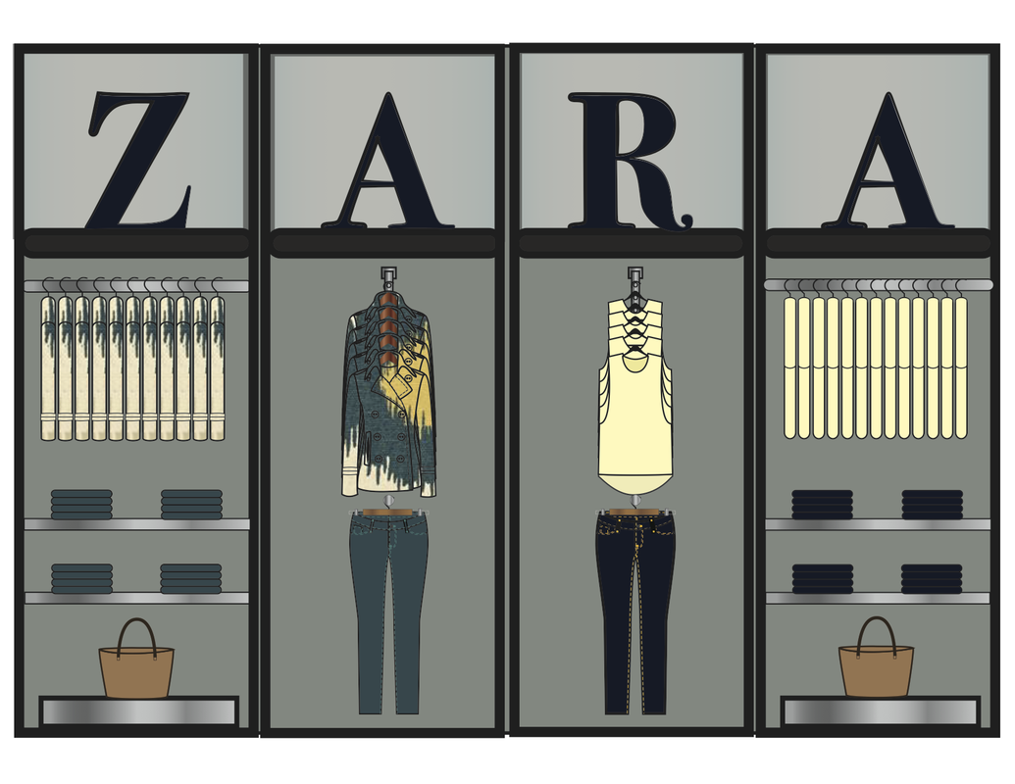
Growing Visual Merchandising Career Opportunities
Growing area-prop house or prop company.
Plan-o-gram

Slide 11
Key Terms
Architect: An architect is a person who plans, designs, and oversees the construction of buildings.
Plan-o-gram: visual representations of a store’s products or services. They are considered a tool for visual merchandising.

