Slide 1
Lauren Gardere

Slide 3
Background
I'm 18 years old
Born in Haiti , in a very family oriented circle.
Grew up living in a country where poverty and crimes took over the town.
Kidnapping = big part of this corrupted country
Nothing ever happened to my family
2004 = took away my uncle.
Why?
He drove a very expensive car
His license plate had my family company logo = upper class
We had to pay a ransom (over 20k)
Thanks to God we got him back in full
My grandpa Thanked, in the newspaper, every individual of the family who shipped in to get the amount needed.
My mother tired of living is this scary and dangerous country = me and my brothers moved to the States with her but that didn’t last long.

Slide 4
MIAMI

Slide 5
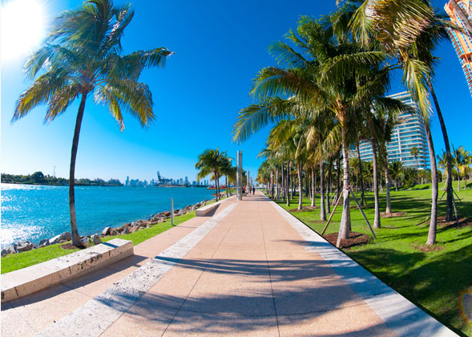

Slide 6
Living in Miami
Mom = American
All children American even though we were born in Haiti = able to live in the US
My brothers went to FIU college and I went to Dr. Gilbert Porter school.
Lived there for 6 months
Back to Haiti because the country was a little better and my father was still living over there so my mom
wanted to be reunited with him again.
Politics took over the city
My mother decided this time that she doesn’t want to stay.
She thought it would be her last change but wasn’t.
We moved to Philadelphia and went back because my brothers didn’t like it.

Slide 7
BACK TO HAITI
The country was again going for a down fall so my family had to take a decision for our best.
My mother and I moved to Montreal 2 years after my brothers did for school
Moved here for school and my brothers
Brothers moved back to Haiti.

Slide 8
Canada

Slide 9
I was bullied a lot.
People not used to little Island girl with attitude
I was also pale compared to the Haitians here (I think they didn’t like me for that)
Throughout high school, made contact with a lot of different people to finally find who I really belong with.
Had to make many big changes and choices to my life.
Girls wanted to fight me all the time and so I would always walk around with something to protect me.
Didn’t like it but had to do what I had to do.

Slide 10
Not much friends = more of my free time doing things to better myself, such as working, going to the gym etc…
I saw that all I was doing was coming back to me with big number$
I realized that I liked the fact of working alone and getting my priorities straight
I made more money and I became happier.

Slide 11
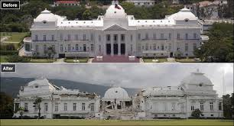
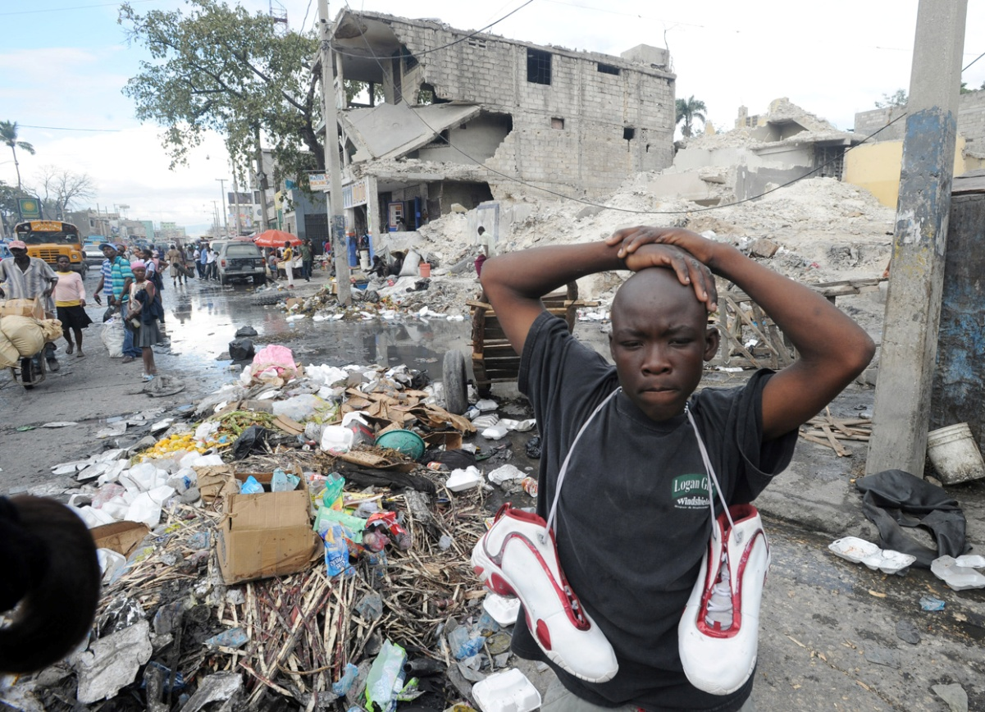
2010 EARTHQUAKE

Slide 12
Haiti had an earthquake in 2010, which didn’t affect my family, Thank God.
My whole family was over there.
Me and my mom were here, in Montreal, and had no control over anything.
Couldn’t talk to no one, cell phones lines were off.
Everything went well afterwards
I realized that all the troubles we went through to finally be where were are, In Montreal, was for a reason.

Slide 13
My mother worked at supermarket
Supermarket = crumbled
Mother + Work = Her life could have been in danger :(

Slide 14
What I learned?
Everything happens for a reason.
Always trust God, he has the best plans for all of us.
Never doubt him, always keep Faith
Life is all about ups and downs
You need dark days to have brighter days
Trust your own path, everything will be find its place
Friends and partying isn’t what is important to me
I rather spend time with my family & make money
My goal = make my family proud and make enough money
Hope to then be able to be reunited with them again to live a
happy, peaceful and BLESSED life.

Slide 15
Have any questions? ☺

