Slide 1
Dimensions of culinary arts
Names: Harshdeep Kaur, Ramandeep Kaur, Eknoor
Instructor: Uzi Paz
Group project: Indian spices

Slide 2
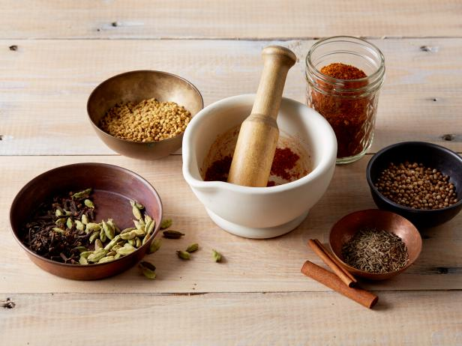
INDIAN SPICES
Indian cuisine is characterized by the extensive use of numerous spices. Spices or Masala as it is called in Hindi, may be called the “heartbeat” of an Indian kitchen.
PowerPoint Designer suggests professional designs for your presentation, based on the content in your slides.
Designer is a subscription-only feature. If you have an Office 365 subscription, the next slide shows you how it works in a new presentation.

Slide 3
INTRODUCTION
By extensive use of spices does not mean eating fiery hot food. They are used to flavor the food, making distinct and aromatic dishes.
Spices are also used as medicinal purposes and to preserve food.

Slide 5
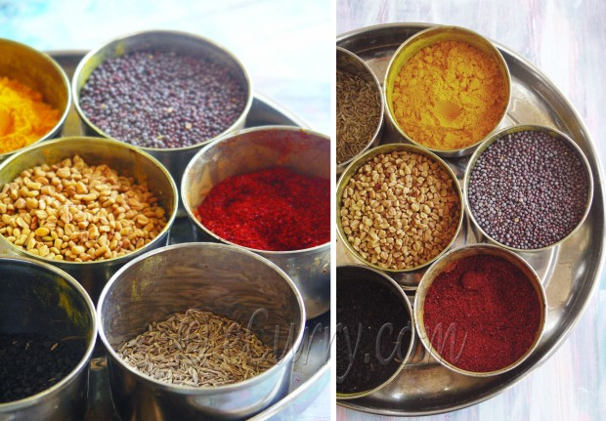
The Masala Dabba (container for spices) that every Indian kitchen owns…
*This container is seen in every kitchen in India, as it is use to keep the whole spices and powdered spices in it.
*List of some basic spices and their uses:

Slide 6
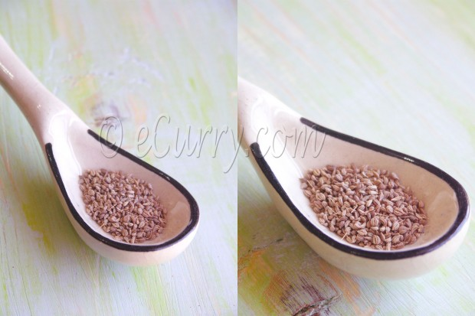
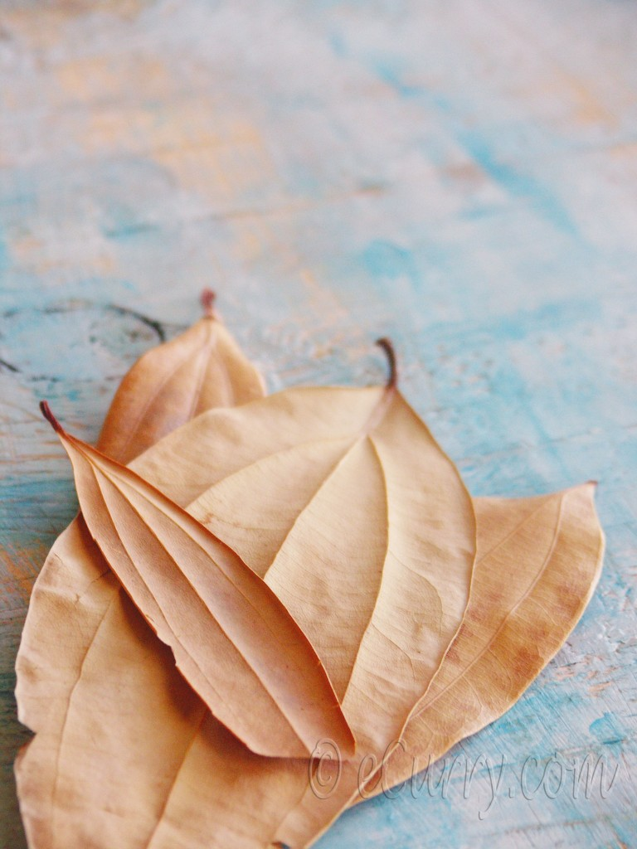
BAY LEAF (tej patta) & carom seeds (ajwain)
1
The Bay Leaf (leaf of the Laurel tree ) used in Western cooking, these are actually three veined leaves of the tree belonging to Cinnamonum group of trees.
Tej Patta or Tamalpatra as it is called in Sanskrit, are used to flavor different curries and rice.
The leaves are aromatic with a slight hint of the fragrance of cinnamon. The leaves are browned in oil first to increase the aroma.
2
(Carom seeds) These are pungent, tiny seeds grayish in color.
It has strong flavor (sharp and bitter on tongue) & smell, closely similar to thyme.
Used rarely as raw in India (especially fried flatbreads).
Beside culinary, it is use as medicinal purposes to aid in digestion.

Slide 7
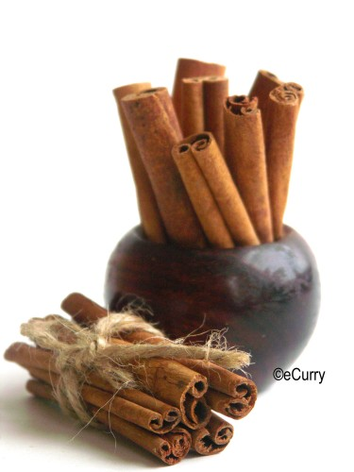
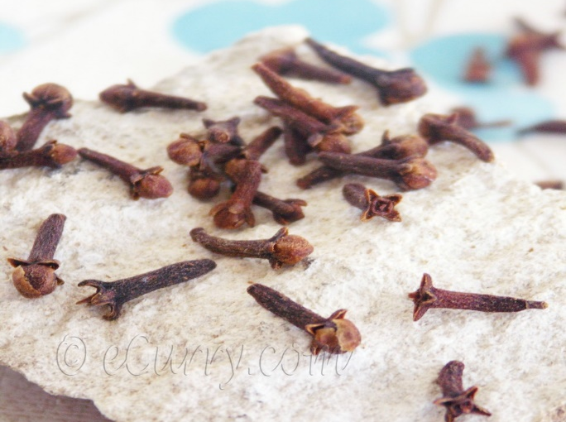
Cinnamon (darchini) & cloves (laung)
4
Cloves are dried flower buds (fully grown unopened buds). They are green hand-picked & dried in sun until turn black.
Used as culinary & medicinal purposes, strong & warm flavor.
3
these sticks are the dried bark of Verum trees grow in Sri Lanka.
two popular varieties of cinnamon; from Chin and from Ceylon.
Both with similar flavors but Ceylon has a sweeter aroma & found in sticks than rolled.
Use in sweet & savory foods.

Slide 8
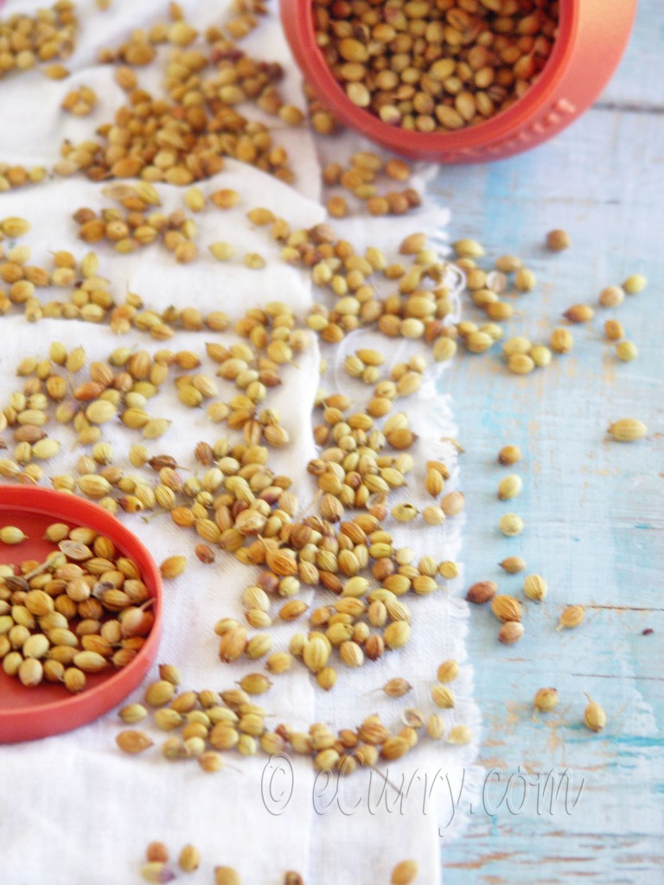
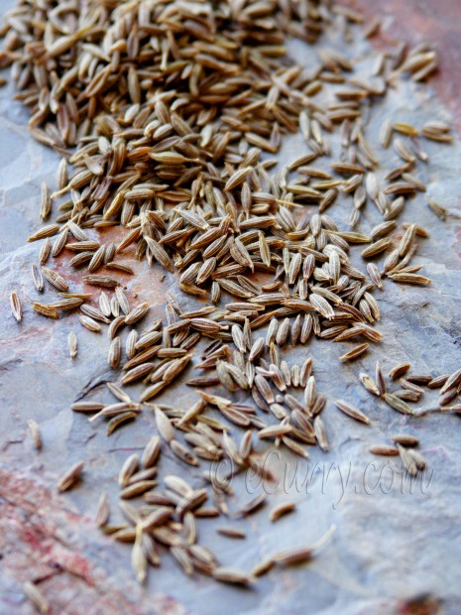
Coriander seeds (dhania) & cumin seeds (jeera)
5
6
Dry seeds of regular fresh coriander/cilantro * Most common spice used all over in Indian cuisine.
Light brown golden color
They can be ground into powder
(mostly used as powder).
* The roasted and fried cumin seeds impart a very unique, smoky flavor to
food.
Notes:
In Slide Show mode, select the arrows to visit links.

Slide 9
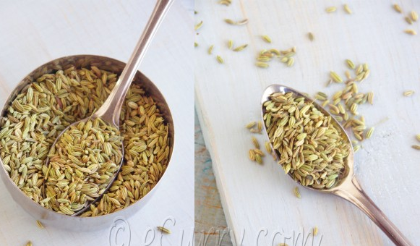
Fenugreek (methi)& fennel seeds (saunf)
8
7
Angular buff colored seeds having a slightly bitter taste. The unripe, raw seeds are cooked as side dishes in certain parts of India and they are not bitter.
might look like Cumin Seeds, but when looked closely they are actually greener and wider. These are also dry roasted and used with tiny sugar candies to make mouth fresheners after meals. Fennel is known for its digestive qualities.

Slide 10
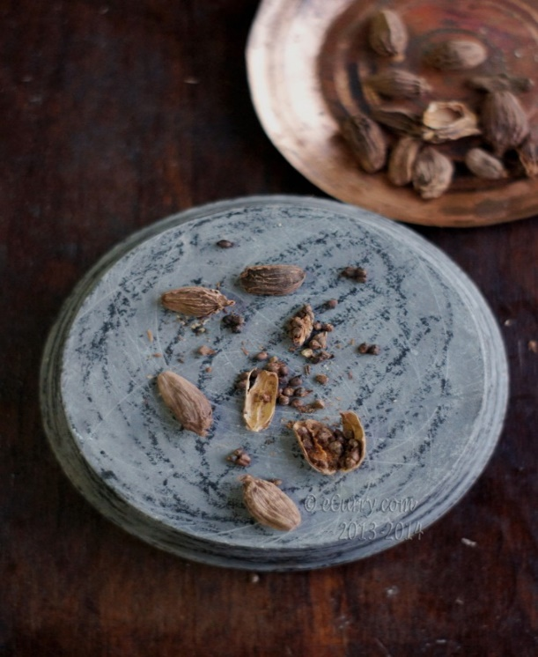
Green Cardamon (Choti Elaichi) Cardamon Black (Badi Elaichi or Kali Elaichi)
9
Cardamom pods holds tiny little black seeds inside. The seeds are taken out and used whole in cooking or in the from of powder. It is used a lot in Indian cooking whether it be vegetables, meat, rice or even desserts.
10
seed pods are about 2.5-3 cm in length and have a bold flavor. These are bigger and very different from the small green cardamoms. The intensity of the flavor emerges as they are cooked slowly and for a prolonged period and that is why it is used a lot for braising food, or flavoring the Indian masala (spice) mix for curries, meats or for stews, lentils and pilafs.

Slide 11
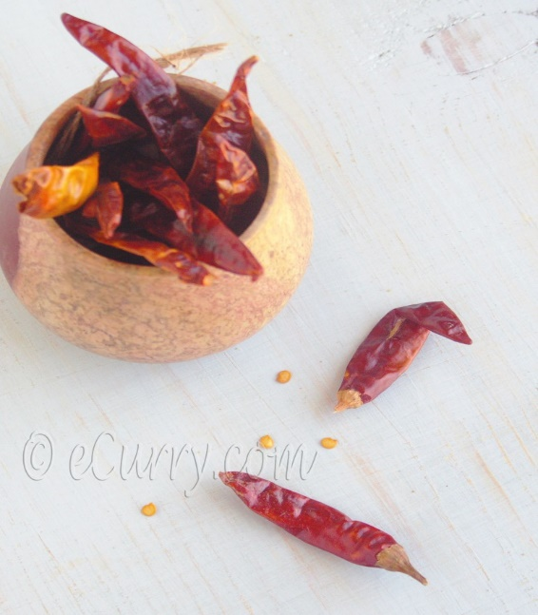
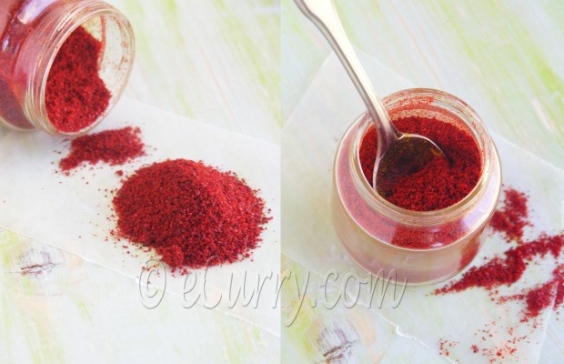
Mustard seeds (rai or sarson)& dried red chilly(lal mirch)
12
11
The black mustard seeds have the most pungent taste. The seeds are usually used to temper/season food by adding them to hot oil. The oil pressed out from the seeds and commonly sold as mustard oil, (can be use as massaging and also for cooking).
This is the hot peppers dried up, esp. the cayenne pepper type. They have different flavor then the green hot peppers, these are usually sizzled in oil and cooked up with the vegetables or meat. These dried peppers may be ground up to make Red Chili Powder.

Slide 12
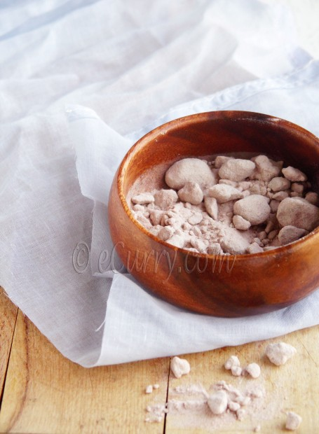
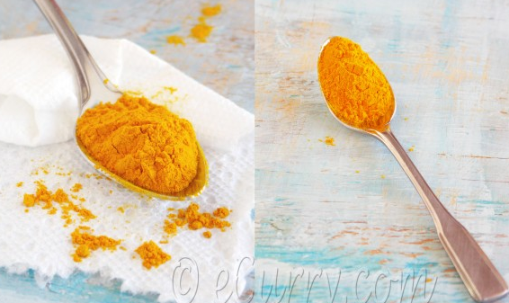
Rock salt (kala namak) & turmeric (haldi)
13
14
Looks like ginger (rhizome in raw state). Freshly grated & used in cooking. Gives nice yellow color to food. Very strong medicinal properties (antiseptic qualities). It can be dried & then ground to make powder.
A salt with unique flavors. Used as garnishes on fresh salads, fruits, vegetables & fried savories. Salt comes in crystal cubes, then ground to make a powder.

Slide 13
conclusion
Spices add beautiful aroma to food. Make food taste really good. Every region or culture has many different kinds of spices. The spices all listed above are the part of “GARAM MASALA”, the most popular & mostly used spice in India.

Slide 14
END OF SLIDE

