Slide 1
Fashion Styling, Photography, and Costume Design

Slide 2
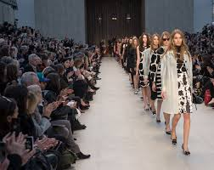
Fashion Show and Event Producer

Slide 3
Fashion Show and Event Producer
Handle advertisemens and public relations
Contact media
Responsible for selecting models and products
Recruits models
Choreograph and rehearse with models for runway presentation

Slide 4
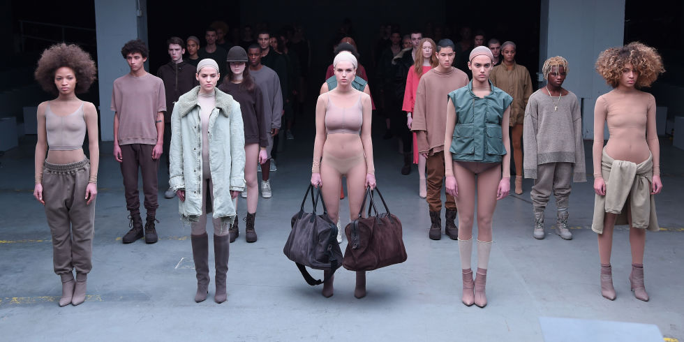
Modeling and Talent agency director

Slide 5
Personal Characteristics
Understanding of fashion marketing
Flexible, Energetic
High level of organizational and logistical skills
Presentation and communication skills
Motivate people
MAKE THINGS HAPPEN

Slide 6
Modeling and Talent agency director
Locating and contacting new models
Training and finding jobs for them
Support and supply them
Types of models :
Fit models → Live models to test garments
Show models → Fashion show models
Photographic models → Commercial (Ads)

Slide 7
Personal Characteristics
Constantly observing those around them
Networking with industry professionals
Good building relationship skills

Slide 8
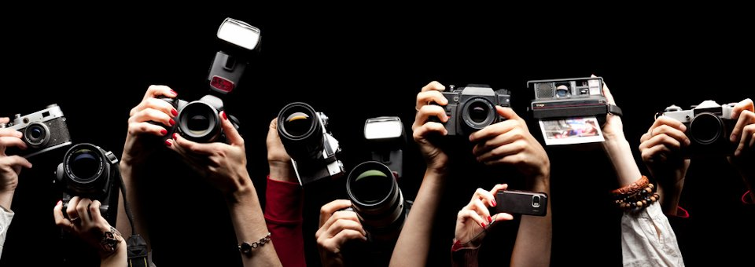
Photography

Slide 9
Photography
Fashion photographer → Takes pictures of models with latest apparel, accessories, hairstyles, make-up, home furnishing and other fashion products
Advertising photography → Expresses a products personality, illustrates a magazines story
Press photography → Images related to news, stories, event and personalities
Technical Photography → Produces photos for reports or research papers

Slide 10
Personal Characteristics
Technical knowledge of cameras
Knowledge of software programs (Photoshop)
Artistic understanding of light, distance and perspective
Inventive skills to communicate moods and ideas

Slide 11
Stylist

Slide 12
Stylist
Photography stylist → Set up the shoot
Fashion stylist → Pull together outfits for their client
Assistant stylist → Contacting public relation companies and retailers, borrow, lease or purchase garments and transport them, in charge of hair, make-up and adjusting the fits

Slide 13
Personal Characteristic
Eye for style and upcoming trends
Knowledge of historical fashion
Creative
Resourceful
Persistent
Interpersonal, presentation and communication skills
Marketing skills

Slide 14
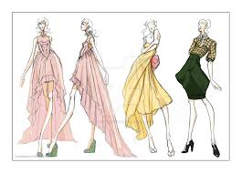
Costume designer

Slide 15
Costume designer
Collaborates with film and video directors
Construct apparel that fit with the visual

Slide 16
Personal characteristics
Creative and resourceful
Understand of historical fashion
Sketching skills

Slide 17
New “KEY” terms
Tear sheet : page that has been pulled out of a magazine
Costume plot : list of chart that shows which character appears in each scene
Fit model : heroes who help make sure the new designs can actually be worn by the rest of us
Portfolio : book that illustrates the job candidate's range of skills and out comes
Fashion visual : fashion shows, photographs, films, costume and wardrobes

Slide 18
List of jobs
Fashion Show and Event Producer
Modeling and Talent Agency Director
Modeling
Photographer
Stylist
Costume Designer

